Slide 1
M210 Campingplatz
Deen Altherr – 27.06.2023

Slide 2
TABLE OF CONTENTS
01
04
About the Project
Sneak Peek
02
05
Major Requirements
Project Stages
03
06
Project Goals
Our Team
Here you could describe
the topic of the section
Here you could describe
the topic of the section
Here you could describe
the topic of the section
Here you could describe
the topic of the section
Here you could describe
the topic of the section
Here you could describe
the topic of the section

Slide 3
Planung

Slide 4
Timeline
ÜK-Start
Präsentation
Informieren
Realisieren
Planen, Entscheiden
Kontrollieren, Auswerten

Slide 5
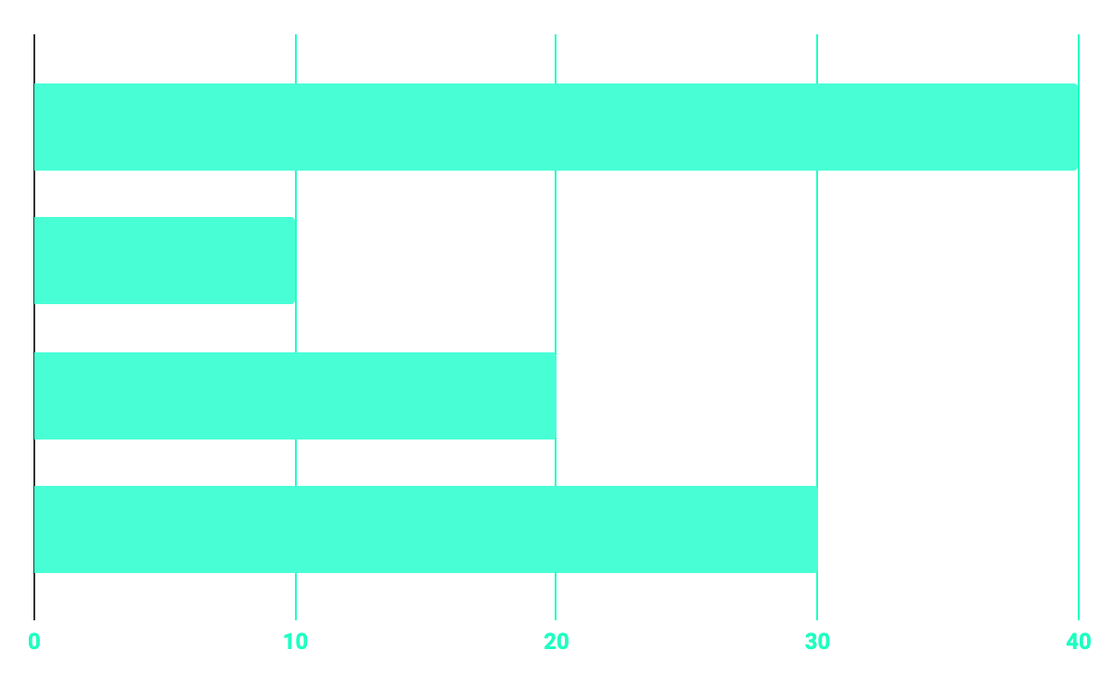
Informieren
40%
20%
Foren/ Quora
10%
30%
Andere Webseiten
Ältere, selbstverfasste Notitzen
Offizielle Dokumentationen

Slide 6
Entscheiden
ERP
Saas, PaaS etc.
Cloud
Modell
Odoo
App

Slide 7
ERP
Enterprise Resource Planning

Slide 8

NetSuite
Oracle
Nicht open source
Ab 99$ / Monat
1998

Slide 9

SAP
SAP
Nicht open source
Ab 645$
1972

Slide 10

Dynamics 365
Microsoft
Nicht open source
Ab 50Fr / Monat
2016

Slide 11

Odoo
Odoo
Open source
Kostenlos
2005

Slide 12
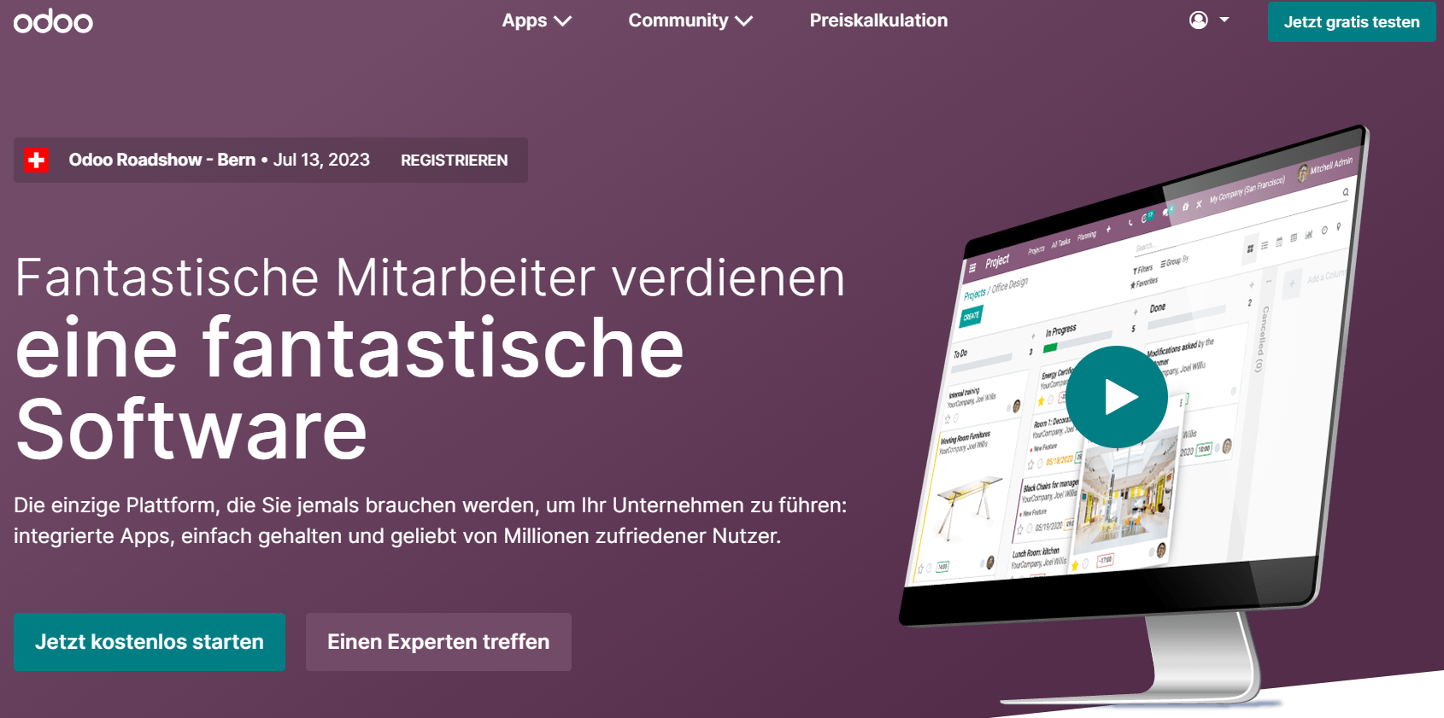
Mehr zu Odoo
Viele Apps
Simple Verwendung
Bekanntheit
Toyota + Decathlon
Cloud oder On-Premise

Slide 13
Cloud

Slide 14
Cloud Modell
Private
Public
Hybrid
- Kostenlos (durch SaaS)
- Simpel
- Unlimitierte Nutzer

Slide 15
SaaS
Software as a Service

Slide 16

Wieso SaaS
Kostenlos
Simpel
Ubegrenzt Nutzer
Skalierbar
Alles an einem Ort
Von überall aus Nutzbar

Slide 17
Vermietungssoftware
Odoo Rental

Slide 18
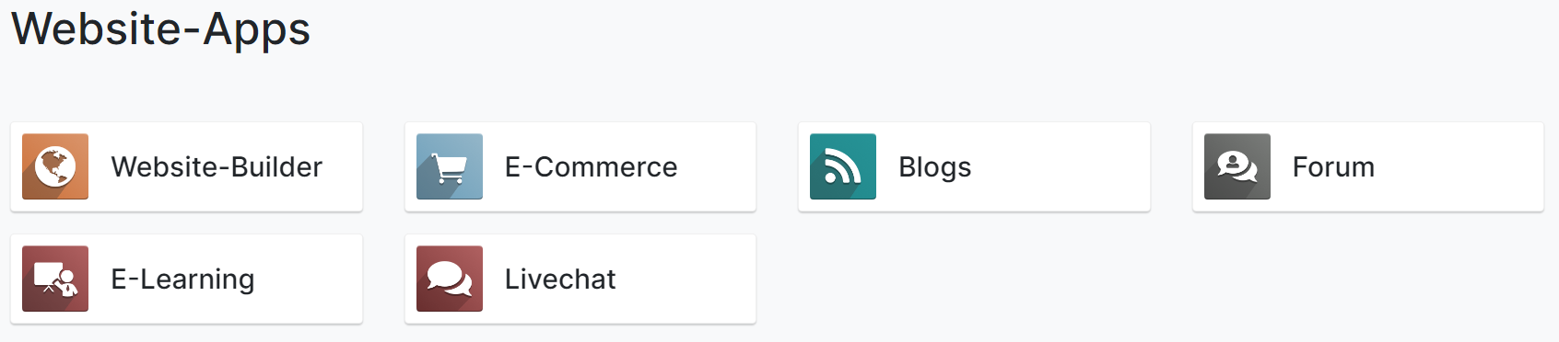
Odoo Apps
Viele verschiedene Apps
Für dieses Projekt «Vermietung»
https://www.odoo.com/de_DE/page/all-apps

Slide 19
Vermietungssoftware
Odoo Rental

Slide 20
Odoo Apps
Viele verschiedene Apps
Für dieses Projekt «Vermietung»
https://www.odoo.com/de_DE/page/all-apps

Slide 21
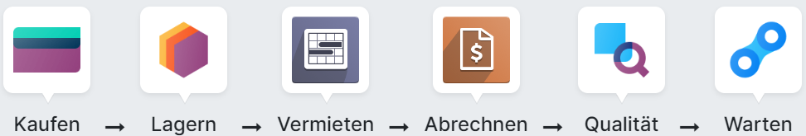
Odoo Vermietungssoftware
Erfüllt alle Anforderungen
Kostenlos
Alles in einem

Slide 22
Reflexion
Reflexion

Slide 23
Odoo Apps
Viele verschiedene Apps
Für dieses Projekt «Vermietung»
https://www.odoo.com/de_DE/page/all-apps

Slide 24
ABOUT THE PROJECT
Mercury is the closest planet to the Sun and the smallest one in the Solar System—it’s only a bit larger than our Moon. The planet’s name has nothing to do with the liquid metal since it was named after the Roman messenger god, Mercury

Slide 25
—SOMEONE FAMOUS
“This is a quote. Words full of wisdom that someone important said and can make the reader get inspired.”

Slide 26
FUTURE
BRANDING
POSITIONING
ADAPTABILITY

Slide 27
MAJOR REQUIREMENTS
IMAGES
USER EXPERIENCE
INFORMATION
Despite being red, Mars is a cold place, not hot. It’s full of iron oxide dust
Venus has a beautiful name and is the second planet from the Sun
Mercury is the closest planet to the Sun and the smallest in our Solar System

Slide 28
BUDGET
40%
20%
PROGRAMMING
10%
30%
DATABASE
WEB DESIGN
UX RESEARCH

Slide 29
OUR GOALS
EXPANSION
POSITIONING
USABILITY
Neptune is the fourth-largest planet in our Solar System
Venus has a beautiful name and is the second planet from the Sun
Despite being red, Mars is a cold place, not hot. It’s full of iron oxide dust

Slide 30
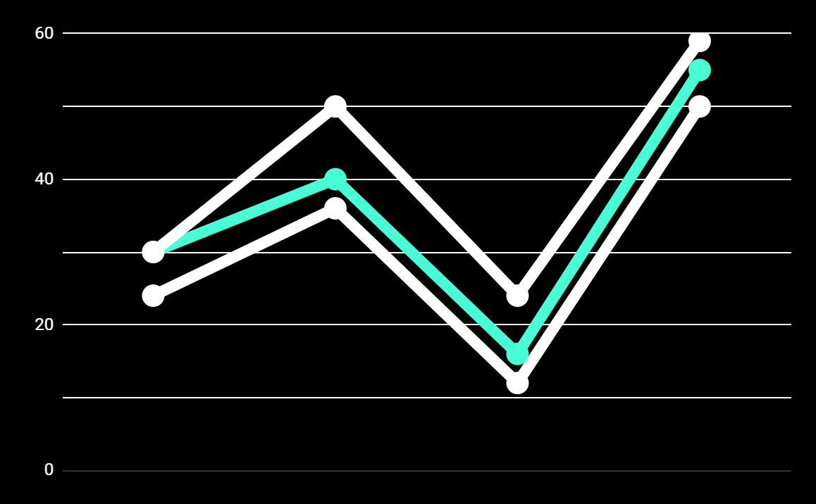
PREDICTED RESULTS
CONVERSIONS NEXT YEAR
+20%
MONTHLY VISITS
+33%
CONVERSION RATE
+40%
ANNUAL ORDERS

Slide 31
SNEAK PEEK
HEADER
TEXT
SLIDER
ICONS

Slide 32
A VIDEO IS A GOOD IDEA
Insert your multimedia content here

Slide 33
PROJECT STAGES
STEP 2
STEP 1
STEP 3
Venus has a beautiful name and is the second planet from the Sun
Despite being red, Mars is a cold place, not hot. It’s full of iron oxide dust
Saturn is a gas giant, composed mostly of hydrogen and helium

Slide 34
OUR PARTNERS
MARS
VENUS
MERCURY
Mercury is the closest planet to the Sun and the smallest one in our Solar System
Despite being red, Mars is a cold place, not hot. It’s full of iron oxide dust
Venus has a beautiful name and is the second planet from the Sun

Slide 35



THE TEAM
JENNA DOE
JOHN DOE
JIMMY DOE
You can replace the image on the screen with your own
You can replace the image on the screen with your own
You can replace the image on the screen with your own

Slide 36
THANKS!
Does anyone have any question?
addyouremail@freepik.com
+91 620 421 838
yourcompany.com

Slide 37
CREDITS
This is where you give credit to the ones who are part of this project.
Presentation template by Slidesgo
Icons by Flaticon
Infographics by Freepik
Images created by Freepik
Author introduction slide photo created by Freepik
Text & Image slide photo created by Freepik

Slide 38
RESOURCES
Did you like the resources on this template? Get them for free at our other websites.
PHOTOS
Young businessman with hands in his pocket talking on mobile phone
Smiling ethnic woman with gray laptop
Smiling young man busy in texting message to someone
VECTORS
Flat computer engineering concept
Circuit of user experience
Timeline infographic
Logotype collection
Flat social media multimedia player templa
Gradient technology logo template collection
Digital marketing landing page template
Colorful responsive landing page
Modern web design concept with hand drawn style
App development concept with flat design

Slide 39
Instructions for use
In order to use this template, you must credit Slidesgo by keeping the Thanks slide.
You are allowed to:
- Modify this template.
- Use it for both personal and commercial projects.
You are not allowed to:
- Sublicense, sell or rent any of Slidesgo Content (or a modified version of Slidesgo Content).
- Distribute Slidesgo Content unless it has been expressly authorized by Slidesgo.
- Include Slidesgo Content in an online or offline database or file.
- Offer Slidesgo templates (or modified versions of Slidesgo templates) for download.
- Acquire the copyright of Slidesgo Content.
For more information about editing slides, please read our FAQs:
https://slidesgo.com/faqs

Slide 40
Fonts & colors used
This presentation has been made using the following fonts:
Roboto
(https://fonts.google.com/specimen/Roboto+bold)
Roboto
(https://fonts.google.com/specimen/Roboto+Thin)
#48ffd5
#0e2a47
#ffffff

Slide 41





Storyset
Create your Story with our illustrated concepts. Choose the style you like the most, edit its colors, pick the background and layers you want to show and bring them to life with the animator panel! It will boost your presentation. Check out How it Works.
Pana
Amico
Bro
Rafiki
Cuate

Slide 42
Use our editable graphic resources...
You can easily resize these resources without losing quality. To change the color, just ungroup the resource and click on the object you want to change. Then, click on the paint bucket and select the color you want. Group the resource again when you’re done. You can also look for more infographics on Slidesgo.

Slide 45
JANUARY
FEBRUARY
MARCH
APRIL
MAY
JUNE
PHASE 1
Task 1
Task 2
PHASE 2
Task 1
Task 2
JANUARY
FEBRUARY
MARCH
APRIL
PHASE 1
Task 1
Task 2

Slide 48
...and our sets of editable icons
You can resize these icons without losing quality.
You can change the stroke and fill color; just select the icon and click on the paint bucket/pen.
In Google Slides, you can also use Flaticon’s extension, allowing you to customize and add even more icons.

Slide 49
Educational Icons
Medical Icons

Slide 50
Business Icons
Teamwork Icons

Slide 51
Help & Support Icons
Avatar Icons

Slide 52
Creative Process Icons
Performing Arts Icons

Slide 53
Nature Icons

Slide 54
SEO & Marketing Icons

Slide 55


